Slide 1


Log your attendance online!
4. Check in with the code
Go to HTTPS://BOURNEMOUTH.LA.JISC.AC.UK/
Press ‘Log in’ and enter your email address.
Log in with your BU username and password.
994509
The code is only active for the duration of the session.
Problems logging your attendance?
Need support?
Contact the IT Service Desk after this session.
https://itservices.bournemouth.ac.uk
Notes:
Option 2: QR code. Add your session code to the Checkin code box.

Slide 2
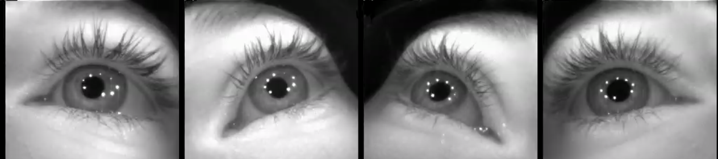
Eye Tracking
You’ll learn: what eye trackers measure • how metrics are computed • how to interpret results
Notes:
[Sources]
- https://arxiv.org/html/2404.15435v1 (tutorial text used throughout)
- https://ar5iv.labs.arxiv.org/html/2404.15435v1 (Figure 4 eye image used as background)
[/Sources]

Slide 3
Session roadmap
1) Devices & setup
2) What we measure
Remote vs wearable vs VR
What affects data quality
Fixations, saccades, pupil, blinks
AOI metrics
3) From samples to metrics
4) Visualize & interpret
Cleaning, segmentation
Event detection (I-VT / I-DT)
Heatmaps, scanpaths
Common pitfalls + ethics
Quick warm-up (30 seconds)
Think of a time you “got stuck” reading a page, searching a website, or preparing your morning coffee — what might your eyes have been doing?
Notes:
[Sources]
- (No external sources)
[/Sources]

Slide 4
What is eye tracking?
Measuring where people look (point of gaze) and how their eyes move
What you get
Why it’s useful
A stream of gaze samples (x, y) over time
Derived events: fixations, saccades, blinks
Optional: pupil size, head pose, scene video (wearables)
Attention & visual search (What draws the eye?)
Cognitive effort (Where do people struggle?)
Usability / learning (How do people explore?)
Safety & real-world behavior (driving, sports, work)
Gaze point
Notes:
[Sources]
- https://arxiv.org/html/2404.15435v1 (definition + overview)
- https://imotions.com/blog/learning/best-practice/eye-tracking-work/ (definition: eye tracking measures point of gaze)
[/Sources]

Slide 5
How do video-based eye trackers work?
Near‑infrared light + camera(s) estimate gaze using pupil + corneal reflections
The basic idea (pupil-centre corneal reflection; PCCR)
What the camera sees
Infrared LEDs illuminate the eye (invisible to us)
Cameras see the pupil + bright “glints” on the cornea
Software estimates gaze direction and maps it onto a screen or scene
Calibration links eye features to known targets
Bright dots = corneal reflections (glints)
Dark circle = pupil
Fun fact
Corneal reflections help compensate for small head movements — improving robustness.
Notes:
[Sources]
- https://arxiv.org/html/2404.15435v1 (video-based tracking; pupil center + corneal reflections)
- https://www.tobii.com/resource-center/learn-articles/how-do-eye-trackers-work (IR illumination + reflections workflow)
- https://ar5iv.labs.arxiv.org/html/2404.15435v1 (Figure 4 image of corneal reflections)
[/Sources]

Slide 6
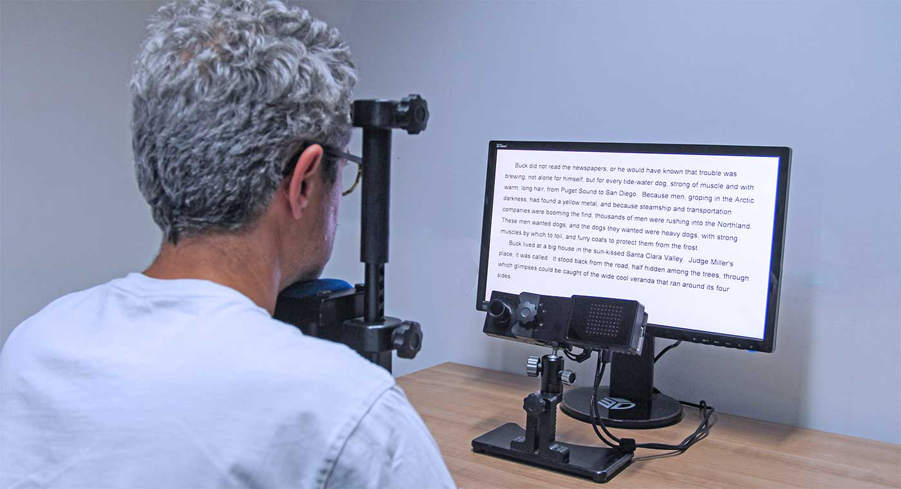
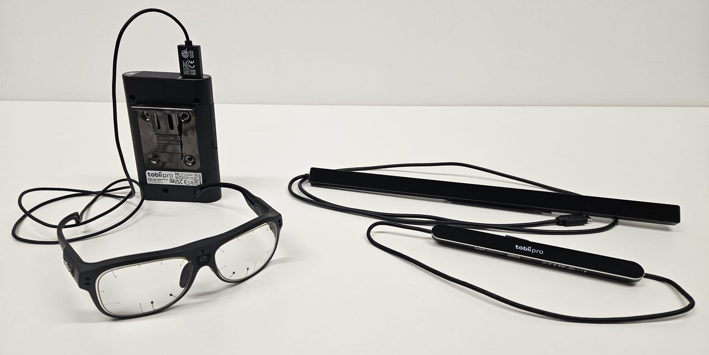
Eye tracking devices (the big families)
Remote trackers, wearable glasses, and eye tracking inside headsets
Remote (screen‑based)
• Great for lab studies
• Often needs stable head position
• Best for 2D stimuli
Wearable (glasses)
• Real‑world tasks
• Includes scene camera
• More post‑processing
VR/AR (in headset)
• 3D interactions
• Need head + gaze together
• Often custom pipelines
Pick the device to match your question
Example: reading on a monitor → remote tracker; navigating a museum → wearable glasses.
Notes:
[Sources]
- https://ar5iv.labs.arxiv.org/html/2404.15435v1 (Figure 3 devices photo)
- https://arxiv.org/html/2404.15435v1 (remote vs wearable descriptions)
- https://www.bitbrain.com/blog/eye-tracking-devices (additional device overview)
[/Sources]

Slide 7
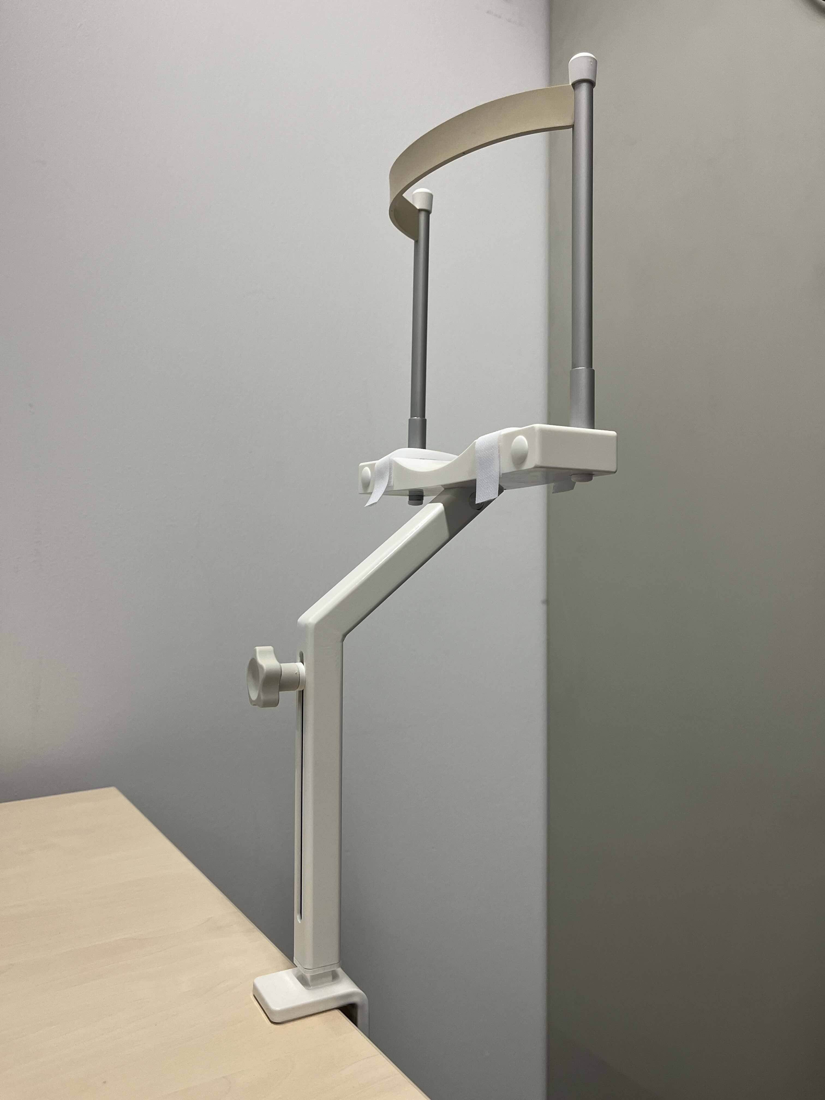
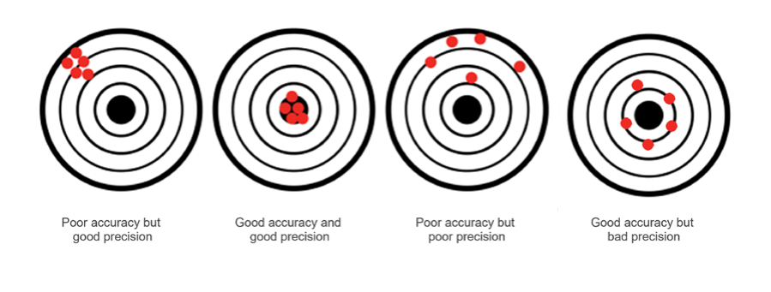
Data quality: sampling rate, accuracy, precision
These determine what you can reliably measure
Practical tip
Key terms
If you need word‑level reading measures or tiny AOIs, prioritize accuracy + head stabilization (e.g., chin rest).
Sampling rate (Hz): samples per second
Higher Hz captures faster movements (e.g., saccades) but produces more data.
Accuracy: how close measured gaze is to true gaze
Precision: how consistent the samples are (scatter/variation)
Common causes of bad data
Poor calibration / drift over time
Glasses glare / heavy makeup / eyelashes
Large head motion or device slippage
Low sampling rate for fast dynamics
Notes:
[Sources]
- https://arxiv.org/html/2404.15435v1 (definitions of sampling rate, accuracy, precision; discussion of calibration issues)
- https://connect.tobii.com/s/article/eye-tracker-accuracy-and-precision (accuracy vs precision definitions)
- https://connect.tobii.com/s/article/eye-tracker-sampling-frequency?language=en_US (sampling frequency definition)
- https://www.biopac.com/wp-content/uploads/Tobii_Pro_Fusion_user_manual.pdf (Fusion sampling up to 250 Hz)
- https://www.tobii.com/products/eye-trackers/screen-based/tobii-pro-spectrum (Spectrum up to 1200 Hz)
- https://www.sr-research.com/eyelink-1000-plus/ (EyeLink 1000 Plus up to 2000 Hz)
- https://ar5iv.labs.arxiv.org/html/2404.15435v1 (chin rest photo Figure 7)
[/Sources]

Slide 8
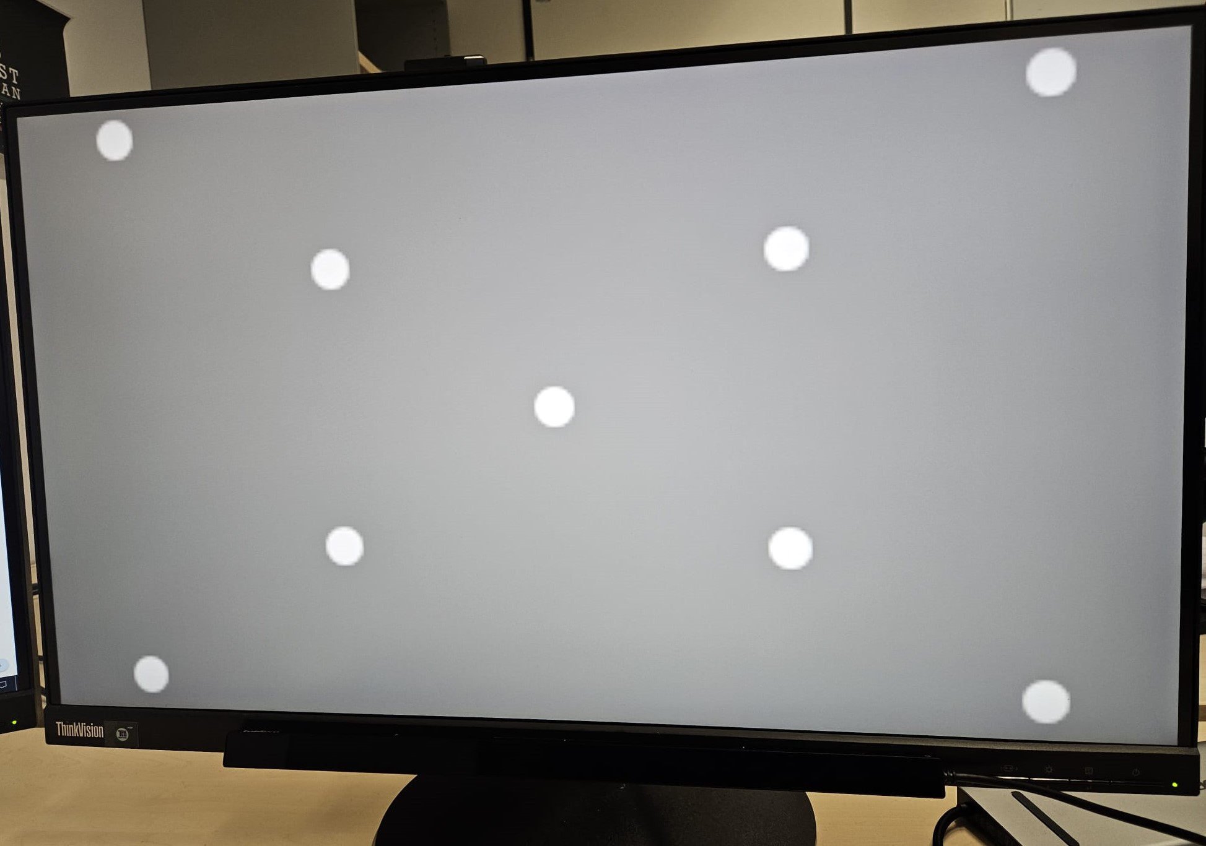
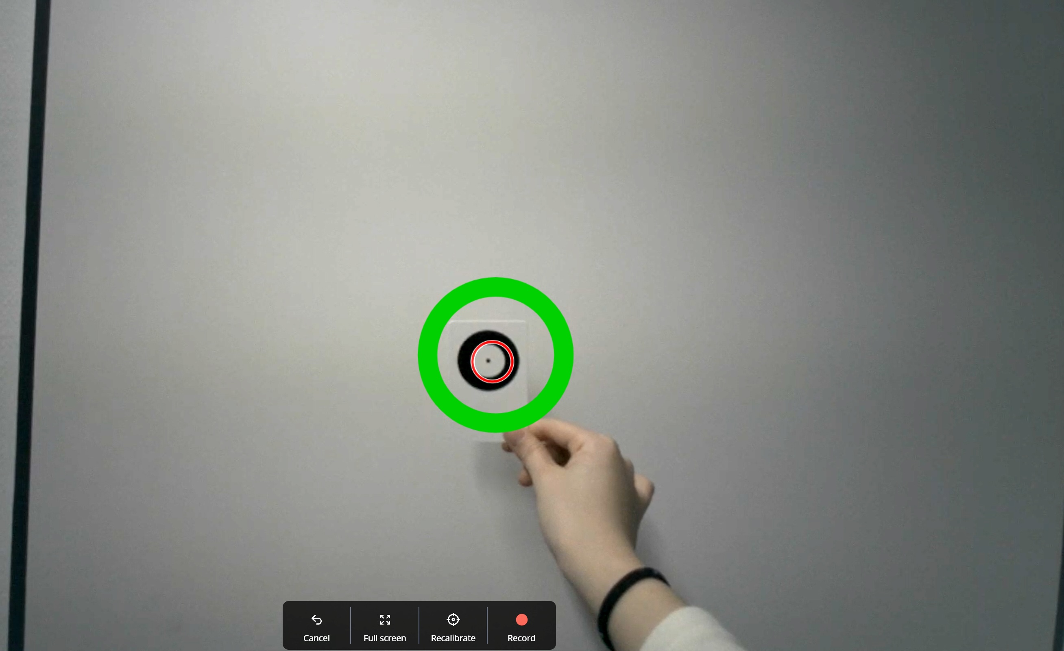
Calibration & validation
Teaching the tracker what your gaze looks like
Screen‑based calibration
Wearable calibration
Typical: 5–9 points. Then validate to check error.
Seat distance + screen position matter
Recalibrate after breaks or if drift appears
Often: look at a marker at a known distance (or multiple markers).
Troubleshooting
If calibration is poor (often with glasses), try repositioning and give a short break before retrying.
Notes:
[Sources]
- https://ar5iv.labs.arxiv.org/html/2404.15435v1 (Figure 5 calibration + troubleshooting guidance)
- https://arxiv.org/html/2404.15435v1 (calibration section + practical advice)
[/Sources]

Slide 9
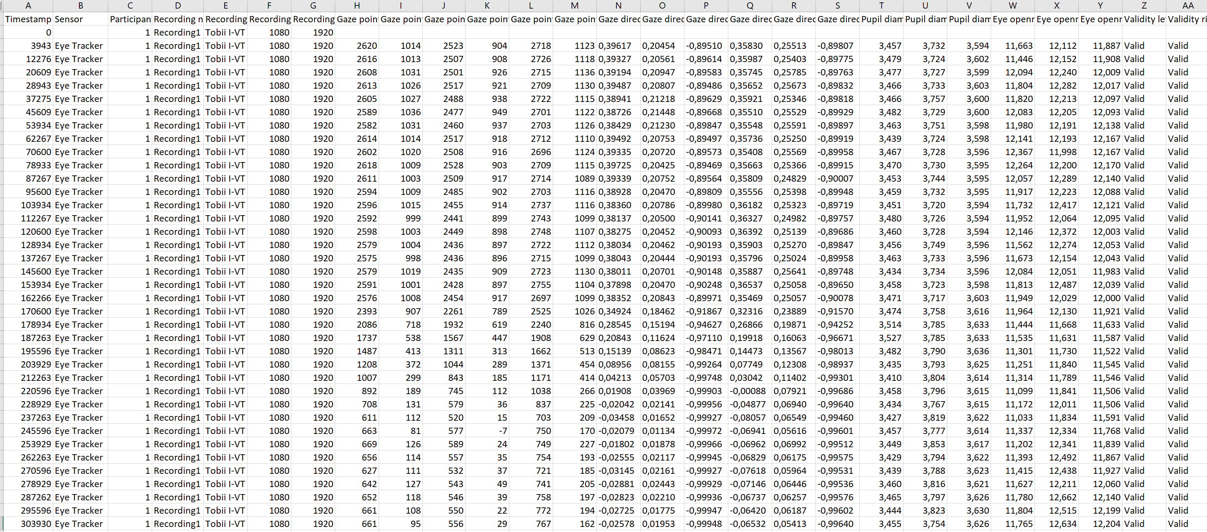
What does eye‑tracking data look like?
Raw data is usually a table (CSV/TSV) with timestamped samples
Common columns
Timestamp
Gaze point (x, y)
Eye validity / trackloss
Pupil diameter
Event markers (stimulus, response)
Big idea
We turn these samples into meaningful events (fixations / saccades), then compute summary metrics.
Notes:
[Sources]
- https://ar5iv.labs.arxiv.org/html/2404.15435v1 (Figure 9 CSV example + description of columns)
- https://arxiv.org/html/2404.15435v1#S4 (Section 4: data processing pipeline)
[/Sources]

Slide 10

Basic eye movements (events)
Most analyses start by identifying these from gaze samples
Fixation
Saccade
Rule of thumb
Eyes stay relatively still
Information intake happens here
Fast jump between fixations
(very brief, high velocity)
Most “attention” metrics are derived from fixations and how they move between areas.
Smooth pursuit
Blink
Eyes follow a moving target
Continuous tracking
Eyelids close briefly
Creates missing samples
Example lab setup
Pupil dynamics
Pupil size changes
(light + cognition)
Notes:
[Sources]
- https://arxiv.org/html/2404.15435v1 (Section 5: fixations, saccades, smooth pursuit, blinks)
- https://www.sr-research.com/eye-tracking-blog/background/eye-tracking-terminology-eye-movements/ (terminology overview)
- https://www.sr-research.com/wp-content/uploads/2023/08/eyelink-1000-plus-eye-tracker-reading-1-1024x556.jpg (setup photo)
[/Sources]

Slide 11
Fixation measures (most common)
Duration and count are widely used for attention and task difficulty
Core metrics
Typical durations
Fixation duration (ms): how long the gaze stays in one place
Number of fixations: how many fixations occur during a task or on an AOI
Total fixation duration: sum of all fixations (per stimulus/AOI)
Fixation rate: fixations per second (sometimes used for workload)
Often ~100–350 ms
(depends on task & stimulus)
Interpreting fixations
Longer fixations can reflect more cognitive effort or difficulty
Experts may show different patterns (e.g., focus on relevant regions)
Always interpret in context (task, stimulus, expertise)
Notes:
[Sources]
- https://arxiv.org/html/2404.15435v1 (Section 5.1: fixations; common duration range; use for attention/cognitive load; expertise effects)
- https://www.sr-research.com/eye-tracking-blog/background/eye-tracking-terminology-eye-movements/ (fixation duration discussion)
[/Sources]

Slide 12
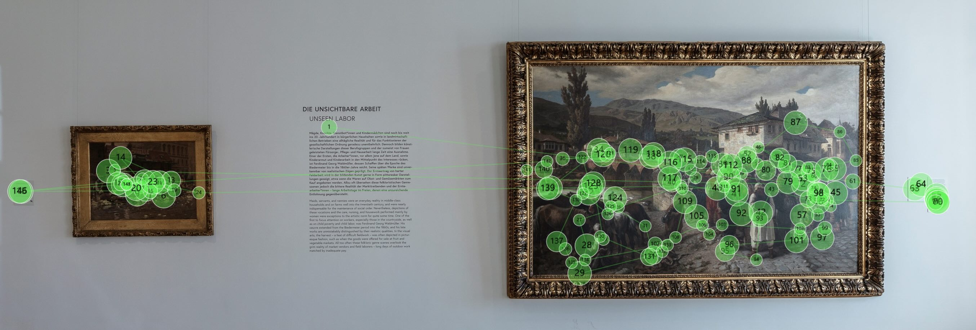
Saccade & scanpath measures
How the gaze moves between fixations
Saccade metrics
What can saccades tell us?
Amplitude: how far the eye jumps (degrees or pixels)
Velocity: speed of the jump (deg/s)
Direction: where the gaze moves next
Saccade rate: saccades per second
Search strategy (local vs global scanning)
Attention shifts (what attracts from a distance)
Comparing novices vs experts
Scanpath (sequence of fixations + saccades)
Common summary stats
Mean / median amplitude
Velocity distributions
Scanpath length
Transitions between AOIs
Notes:
[Sources]
- https://arxiv.org/html/2404.15435v1 (Section 5.2: saccades; velocity/amplitude interpretations)
- https://www.sr-research.com/eye-tracking-blog/background/eye-tracking-terminology-eye-movements/ (saccade terminology)
[/Sources]

Slide 13
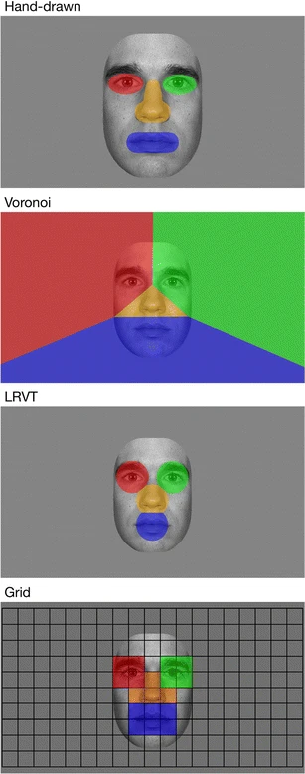
AOI metrics (Area of Interest)
Summarize attention to meaningful regions (buttons, words, faces…)
AOI examples (face processing)
Common AOI measures
Dwell time (time spent) on AOI
Time to first fixation (TTFF)
Fixation count on AOI
Revisits / returns to AOI
Sequence of AOI transitions
Site header
Manual/figure drawing
Voronoi
Interpret with care
Long dwell time can mean interest… or confusion. Pair eye metrics with task performance and think‑aloud when possible.
Notes:
[Sources]
- https://arxiv.org/html/2404.15435v1 (AOIs + metrics discussion across sections)
- https://imotions.com/blog/learning/10-terms-metrics-eye-tracking/ (dwell time, TTFF and other AOI metrics)
- https://connect.tobii.com/s/article/understanding-tobii-pro-lab-eye-tracking-metrics (AOI metrics definitions such as duration/glances)
[/Sources]

Slide 14
Pupil & blink measures
Useful, but require careful preprocessing
What we can extract
Interpreting pupil & blinks
Pupil diameter / pupil dilation (changes over time)
Blink rate and blink duration
Trackloss periods (often align with blinks)
Pupil size is strongly affected by lighting — control luminance!
After control/baseline, pupil dilation can reflect cognitive effort
Blink rate is sometimes studied as workload / fatigue signal
Why preprocessing matters
Blinks create missing values and sharp spikes. A common pipeline is:
1) remove invalid samples
2) smooth noisy segments
3) interpolate short gaps
4) baseline‑correct pupil size
Notes:
[Sources]
- https://arxiv.org/html/2404.15435v1 (Section 4.1 smoothing/interpolation; Section 5.4 blinks; pupillary analysis notes)
- https://arxiv.org/html/2404.15435v1 (blink rate links to cognitive load in cited studies)
[/Sources]

Slide 15
From samples → fixations & saccades
Simple event detection: I‑VT (velocity) and I‑DT (dispersion)
I‑VT (Identification by Velocity‑Threshold)
I‑DT (Identification by Dispersion‑Threshold)
Compute point‑to‑point gaze velocity
If velocity < threshold → fixation sample
Group consecutive fixation samples into fixations
Enforce minimum fixation duration (e.g., 60–100 ms)
Slide a time window over samples
Compute spatial spread (“dispersion”)
If dispersion < threshold → fixation
Else → saccade / transition
Typical threshold (example)
Why thresholds matter
Many studies use ~30–50 deg/s for I‑VT (then tune for your task & tracker).
Too strict → split real fixations into many small ones.
Too loose → merge separate fixations.
Always report your algorithm + parameters.
Notes:
[Sources]
- https://arxiv.org/html/2404.15435v1 (Section 5.5: I‑VT and I‑DT; velocity threshold example 30–50 deg/s)
- https://arxiv.org/html/2404.15435v1 (Salvucci & Goldberg 2000 referenced as classic algorithms)
[/Sources]

Slide 16
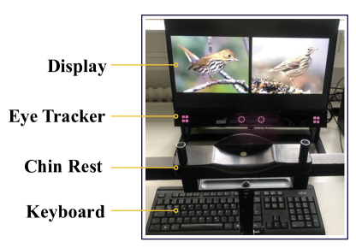
Data processing pipeline (end‑to‑end)
A practical workflow for reliable metrics
1) Clean
2) Filter
3) Segment
4) Detect
5) Extract
6) Analyze
Remove invalid
trials & samples
Smooth noise
Interpolate gaps
Split by
condition/events
Fixations
Saccades
Blinks
Metrics (AOI,
scanpath, pupil)
Stats +
visualizations
Example: what “cleaning” can remove
Good practice checklist
Define exclusion rules before you look at results
Log task events (stimulus onsets, responses)
Report algorithms + thresholds (I‑VT/I‑DT etc.)
Visualize data (heatmaps/scanpaths) as sanity checks
Notes:
[Sources]
- https://arxiv.org/html/2404.15435v1#S4 (Section 4: cleanup, filtering, segmentation, feature extraction)
- https://ar5iv.labs.arxiv.org/html/2404.15435v1 (Figure 6 data collection setup image)
[/Sources]

Slide 17
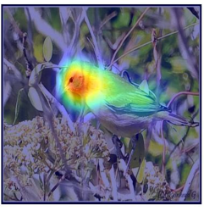
Visualization 1: heatmaps (saliency maps)
Aggregate fixations into a “hot–cold” attention map
How they’re built
Start with fixation locations (x, y)
Weight by duration (optional)
Apply a Gaussian blur around each fixation
Sum across time or participants
What to say out loud
Heatmaps are great for “where” questions, but they hide the order of looking. Use scanpaths for sequence.
Notes:
[Sources]
- https://arxiv.org/html/2404.15435v1 (Section 7.1: saliency maps; Gaussian blur approach)
- https://ar5iv.labs.arxiv.org/html/2404.15435v1 (Figure 16a heatmap image)
[/Sources]

Slide 18
Visualization 2: scanpaths & gaze plots
Show the order of attention (sequence + movement)
How to read it
Dots = fixations
Bigger dots = longer duration
Lines = saccades
Numbers = order
Notes:
[Sources]
- https://arxiv.org/html/2404.15435v1 (Section 7.2 scanpaths; dot size reflects fixation duration)
- https://ar5iv.labs.arxiv.org/html/2404.15435v1 (Figure 18 scanpath image)
[/Sources]

